Slide 1

Evolving Virtual Creatures
Ishmail Qasim 180021745 08/2021
Notes:
Hello and welcome to the demo for my final year project.
Today, I will be bringing to light, my project on Evolving Virtual Creatures.
Giving insight into my experience and developments.

Slide 2
Pitch
Develop a virtual creature inside a virtual space.
Experiment with computationally intelligent algorithms to simulate evolution.
Question if current models of technology or resources are optimal or how they can become optimal.
Inspired by Karl Sims’ Evolving Virtual Creatures project.
Long term product – design testing platform for innovators and engineers.
Notes:
Firstly, let’s break down what this project is.
Evolving Virtual Creatures is about experimentation with computational intelligence, in order to design a creature or device that is able to genetically evolve into higher optimality.
This objective is carried out by manipulating real world physics to generate a virtual testing space before inserting a device for simulation of evolution. Evolution being the process of regenerating in a way that achieves higher creature fitness.
Typically fitness factors environmental aspects but this is omitted in this project.
This project is inspired by Karl Sims’ project of the same name and many of the aspects will be directly related and compared to the successes of his project. Further explanation to follow.
The accumulation of all this work aspires to materialize as a design testing platform for innovators and engineers to test designs, criteria’s or upgrade concepts.

Slide 3
Defining Evolution
“…decent with modification…”
- Charles Darwin
“Evolution may be defined as any net directional change or any cumulative change in the characteristics of organisms or populations over many generations—in other words, descent with modification… It explicitly includes the origin as well as the spread of alleles, variants, trait values, or character states.”
– John Endler
Notes:
I mentioned it briefly but lets take a moment to define Evolution, which I described in the last slide as “genetically evolving into higher optimality”.
Optimality in context of evolution is abstract and based on the effects of the change in a creatures genetics, so we should discuss the effects of evolution rather than what is optimal.
Simply put, evolution is the process of a creature’s make up or instruction changing to better suit their environment. In our context, in efficient task completion.
Darwin originally defined this as “decent with modification” as in reality, changing genetic structures of a creature may not always produce a fitter creature. And if a creature is not fitter, can we define that creature as evolved?
John Endler also stated that… (read quote)
It’s with this understanding that we can proceed with the conceptualisation of this project.

Slide 4
Original Scope
Bipedal creature (human like).
Simulate plausible and visible evolution cycle.
3 tasks:
Travel from A to B. Clear course.
Travel from A to B. Obstacle course.
Transport package from A to B.
Develop logic in 2D and move toward 3D for more plausible results.
Notes:
Now let’s talk about scope. More importantly about what it was initially, and about what it is currently.
At the beginning, I was an innocent, bright eyed youth, ready to take on the world. Having very high expectations of myself and my abilities.
This lead me to initially aim to develop an evolutionary simulation that effected a human like creature.
With this bipedal creature, the aim was to be able to affect the creatures limbs by their density, size, mechanical restraints, motor force and connection strength.
Later developments would also aim to affect the number of limbs or appendages that may exist on the creature.
With these developments, I would aim to throw the creature at 3 different tasks to monitor the differences in development and perhaps perceive an evolved structure that is highly effective in all 3 tasks.
If this were to happen, it would be a huge success as it would demonstrate the effectiveness of this simulation software.
The tasks in question are:
First, travelling from point A to B.
Secondly, travelling from point A to B with obstacles in the way.
And lastly, enabling the creature to hold/pick up objects and transport them.
Task 1 would originally be developed in a 2D space to figure out the logic, integration with a reduced number of variables unavailable to us by the lack of a 3rd dimension.
Once completed, it would hypothetically be simple enough to transport the logic from a 2D virtual space to a 3D one. Then accounting for the new variable requirements like the z-axis directional movement.

Slide 5
New Scope
Bipedal discarded. Car design instead.
Limited to 2D realm.
2 task
Travel from A to B, clear course.
Travel from A to B, obstacle course.
Balancing speed, torque, impulses.
Notes:
The new scope in contrast, discards the idea of a human like, bipedal creature in place of using a car design instead.
This doesn’t mean the scope has shrunk, but only the expected level of progress has.
In the development of this project, we would have gone through a development stage that involved a simpler, more rigid creature design like this car. To test if the mechanics of physics, joints, fixtures and the evolutionary algorithm is functional.
In development, it is easier to illustrate the effectiveness of code when it is being performed on a simpler, more controllable task. And this is provided to us through a car designed creature.
The project at this stage also chooses to ignore 3D implementation and opts to develop in the 2D realm.
Although plausibility and applicability is compromised because of this, A 2D model would afford us more time to develop the evolutionary process, and really flesh out our understanding of the evolution cycle in action.
In discussions with my previous personal tutor, Dr Peter Lewis, there was a mutual consensus in developing a fleshed out 2D implementation in place of a rudimentary 3D implementation.
The number of tasks were reduced in that transporting a package was no longer going to be tested at this stage.
And the controls that were going to be modified in the 3D implementation has been reduced to speed, torque and impulses. These will be explained later on.

Slide 6
Why the new scope?
Pandemic/Lockdowns:
Lack of freedom.
Blurring the lines between work time and free time.
Burn out.
Difficulties with physics engine.
Lack of consideration as to the complexity of scope.
Notes:
So okay.
We had a scope and then we changed that scope.
In fact, we changed that scope twice before materialising what I just spoke about.
But can you blame me? Bright eyed youths have a tendency to overzealous behaviour!
There were multiple reasons for scope change and I’ll try to illustrate these without attempting to curry your sympathies.
The most problematic factor in adapting the scope to what it is now was the pandemic. No doubt this affected all of us.
It was terribly difficult to focus when feeling trapped in a box, worse so when most of that time is spent sat in front of a desk in thought.
Studying during a pandemic for over a year between the latter section of my 2nd year and the whole duration of my final, accumulated into a lot of work based burn outs.
It was difficult to drive a clear cut wedge between work time and free time because there was no place to leave, no ritual to perform nor psychological trigger to shut off.
This led to a sense of feeling that no matter how much work I did, it was never enough. And after plugging away for hours and hours, the mind began to stop cooperating.
This lead to large periods where progress was not made. Large bouts of pushing work back with a deadline that was not moving with it.
The other major reason for rethinking the scope was the complexity of the physics engine I chose to use. Or rather the lack of documentation.
I chose to use jBox2D to consolidate the physics and this was the source of my largest frustration and time sponge. More on this later.
These in combination made the original scope infeasible as this was a complex investigation I was tackling with difficulty understanding how to approach it, all while the clock was ticking.
This is why the scope changed.

Slide 7
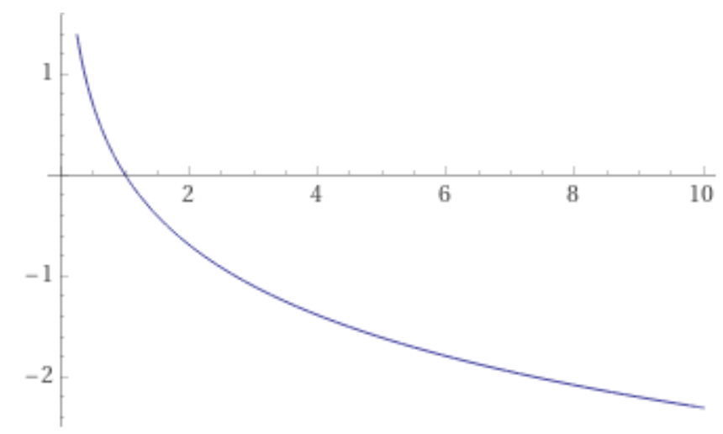
Expectations
Ability to pre-set a task.
Set any car creature model on the task.
Observable effectiveness of a rudimentary evolutionary algorithm.
The rate of improvement should progress in a -log(x) curve.
Test viability and improvement.
Notes:
With the reduction in scope, what was expected of this project was simply to produce a system that was capable of approaching a pre-set task and throwing any car creature in its way, equipped with an evolution system.
This project should be able to highlight the effectiveness of a rudimentary evolutionary algorithm with the context of its design and any improvements that can be made on it.
Rudimentary due to the available time scale left between all the road blocks.
The level of efficiency of the evolutionary algorithm should be observable and should effectively display a progressive evolution rate akin to a negative logarithm of x.
Which should initially be at a higher rate on start evolutions and a lower rate as time progresses, because we can assume the genetic model is improving and coming closer to optimality.
We should be able to throw any configuration of a car model and test immediately the viability of the model, whether a viable alternative can be conceived and then a more efficient version of that model.

Slide 8
Background
Genotype
Phenotype
Genetic configuration
Genetic Output
Notes:
Next I’d like to talk a little bit about the background to this project and Karl Sims as an influence.
But before I can do that, I’d like to take a moment to just define a couple of terms that will now begin to appear frequently in this demo.
These terms are genotype and phenotype.

Slide 9
Genotype – Phenotype 1
Genotype/Genome
Variable genetic combination.
Combinations elude to but not strictly define output.
Can’t be seen.
Phenotype/Phenome
Takes genetic combination and produces a genetic trait based on it.
Can be seen.
Notes:
Both terms are as equally important as the other when we discuss evolution and genetic configuration.
Genotypes are defined as a combination of alleles, or genes that a creature possesses.
While phenotypes are defined as a creature’s traits or observable characteristics as a result of the make up of their genotype, or genome.
Genotypes don’t explicitly define the observable traits of a creature.
Only it creates the genetic instructions that the phenotype can act upon.
Allow me to illustrate this.

Slide 10
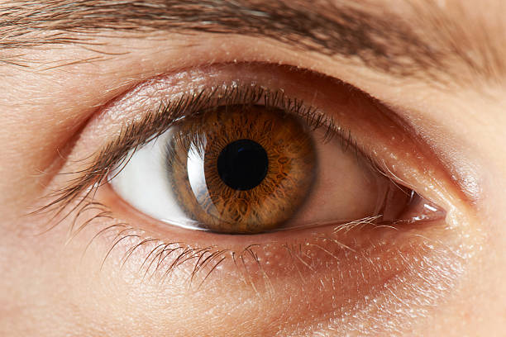
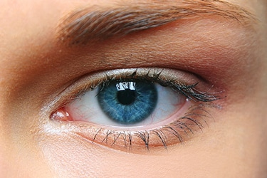
Genotype – Phenotype 2
Brown (B) : Blue (b)
BB
Bb/bB
bb
Notes:
Bearing in mind, this is a hyper simplification of the definition.
Lets say we have 2 extremely affectionate adults that are 2 children and a dog away from living the American dream of having a detached home, a 9 to 5, a Ford pickup truck, 2.4 kids and the wife wants to have her first child.
Let’s also say the husband’s eyes are brown and the wife’s eyes are blue.
What colour will their children’s eyes be?
In this context, we have defined the phenotype of this problem to be the iris colour of their offspring and the genotype are the iris traits inherited by both parents.
If we define brown eyes to be a gene called, capital B.
And then define blue eyes to be lower case b.
We can see from the example on screen that we have 3 possible configurations of the genome with only 2 possible phenetic outputs.
And this is exactly what was defined as genotypes and phenotypes,
That although the heterogynous genome of Bb/bB eludes to the possibility of both Brown or Blue eyes, but in reality the phenotype output for this is always brown.

Slide 11
Background – Karl Sims 1
Karl Sims Evolving Virtual Creatures (1994).
Developing complex creatures with plausible motion.
4 behaviours:
Walking
Jumping
Swimming
Following
Neural layer = Genotypes
Muscular layer = Predefined phenotypes
Specified torques, angle of freedom, collision response etc.
Evolution occurs on phenotypes with some mutations in genotypes.
Notes:
Moving on, in 1994, Karl Sims created his very own project of the same name that inspired my investigation.
Sims, set out to investigate if it was possible to create plausible behaviour from highly complex virtual creatures and theorised that, as complexity increases, the possibility of achieving and maintaining a complex creature with plausible motion, reduces.
In other words, while it is still possible to create a life-like walking motion from a bipedal creature, this would be extremely difficult or infeasible to produce from static development. This is where evolution enters the ring.
Sims determined that focusing on 2 aspects of the genetic cycle was paramount to making this work.
These were to focus on defining behaviours to give the evolution some direction or sense of fitness. While the other aspect was to focus specifically on evolving the creature using it’s phenotypes.
The defining behaviours are Walking; Jumping: Swimming; and Following.
The idea was to focus on getting the creature closer to one of these specified behaviours, while narrowing the range of randomness in creature design.
While the creature was divided into neural and muscular layers, encompassing genomes and phenomes, respectively,
Evolving the phenetic structure of the creature caused more effect to a creature’s observable behaviour but it was important that the effect produced was within the bounds of expected results.
This is why Sims also opted to pre-define phenotypes to specify their effect on the creature.
If you think about a human learning to walk.
A specific phenotype that limits the angle of freedom of the knee to a 2 dimensional range of motion makes a lot more sense than allowing the knee joint to bend out side ways.
At least to me anyway. Maybe not so much to the pogo stick humans of the pogo stick dimension.
It’s through this combination that allowed Sims to tackle his early hypothesis of plausible motion in a complexly designed creature being unachievable through static means. Not so much through dynamic means.

Slide 12
Background – Karl Sims 2
‘Mating’
Crossover
Grafting
Gaussian variation in evolution.
Real world environmental physics.
Body dynamics (rules bodies should abide by).
Collision detection.
Collision response.
Fraction and fluid effects.
Notes:
That covers Karl Sims’ “What”, but now I’d like to quickly talk about his “how”.
Briefly put, Sims applied a combination of 2 computationally intelligent evolutionary algorithms.
Crossover and Grafting.
And these are activating during what Sims dubs as the process of ‘mating’.
Where, much like the iris example above,
A set of parents will come together to create a child, or more technically, produce offspring, that is made up of a combination of both of their genetic build ups.
The 2 ways this can occur is by dominantly inheriting the genome of one parents and swapping some of the genes for the genes that exist in the genome of the other parents.
Or by take a slice such as the first half of the first parent’s genome and the remaining slice of the 2nd parent and combine these to create a new genome.
The former is the definition of a crossover evolution, and the latter of grafting evolution.
And when these evolutions occur, controlled mutations occur that reflect the gravity of the gene it is imposing itself on.
This means that if the value in mutation is small in nature, so will the adjustment. The same occurs in the opposite direction for large objects and anything in between.
This helps to achieve a gaussian pattern across genomic mutation.
Sims ensured this process occurred in a real world type of environment to add to the plausibility factor of the creature.
And the physics imbued in this system determined the dynamics of bodies, whether collision occur and how to respond to them, fractional and fluid dynamic effects and more.

Slide 13
Physics and jBox2D - 1
Box2D (C#)
jBox2D (Java port)
jBullet (now discarded 3D engine)
Physics:
Mass (weight excluding gravity)
Force (force = mass*acceleration)
Torque (potential rotational energy)
Impulses (impact forces)
Representations:
m_speed
m_torque
m_hz/dampening frequency
fd.density
fd.friction
Notes:
Moving on, when it came time to build the scope for this project, there was a decision that had to be made.
How would I consolidate the physics of this virtual space in each dimensional format?
Upon recommendation from my previous FYP supervisor, I looked into Box2D which is dubbed to be a highly popular 2D physics engine. jBullet was also recommended as a 3D physics engine but this was discard in the scope change.
Though because the language was in C#, I had little confidence in learning a new language if I hadn’t already achieved mastery of Java and instead decided to look for java alternatives. Unbeknownst to me that C# and Java was very similar languages. Probably my biggest blunder.
In looking for alternatives, I came across the java ported version of Box2D, and with Peter Lewis’ recommendation coupled with java use, this was a match made in heaven!
jBox2D has it’s defining perks in that models and tests of the features are pre set up to demonstrate the capabilities of the engine and what features is housed. And this nearly made up for the lack of documentation.
Inside jBox2D, houses some fundamental forces that guide the processing of all mechanics in the engine.
These are Mass, Force, Torque and Impulses and these are represented in a variety of these tests and as speed, torque, dampening frequency, density and friction.
These forces are consolidated in the system through joints and fixtures.

Slide 14
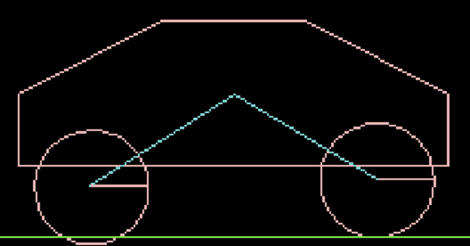
Physics and jBox2D – 2
Joints – Wheel Joint.
m_speed = peak rotational speed.
m_torque = rate of potential force.
m_hz = response rate to impact/speed of oscillation.
fd.density = strength of joint.
fd.friction = how grippy the wheel is.
Notes:
Joints and Fixtures are connective junctions where bodies are linked together, with the major difference being that joints are the only connector that is dynamic of the 2.
Joints determine motion, angle of freedom and their own sets of limitations and there are many such as piston, revolute, pendular, wheel joints and more.
But due to project complexity, I decided to limit my time spent learning how to the engine worked and creature complexity and stick solely to wheel joints.
Wheel joints are pretty self explanatory. It’s a round thinga mobob that spins.
The force representations integrate into the wheel joint through it’s fundamental components.
m_speed determines max rotational speed of the wheel.
m_torque determines how long it takes for wheels to reach max rotational speed.
m_hz determines the responsiveness of the wheels to impact forces, otherwise known as suspension in a car. The stiffness here requires balancing, as too little will not prop the body up and end up making the friction too high to generate any forward force.
fd.density determines how strong that connection link between wheel and car is.
And fd.friction determines how sticky the car is to the ground, or by some effect, how much torque can be applied before losing grip.

Slide 15
How it works
Modifying existing car test.
Generating objective.
Deciding on fitness evaluation points.
Fitness evaluation.
Genotype:
Perbutative Greedy tour Algorithm.
[Generation, Best Time, Current Time, Evolutions, Wheel Radius 1, Wheel Speed 1, Wheel Torque 1, Dampening Frequency Wheel 1, Wheel Size 2, …]
Notes:
How it works.
In jBox2D, contains a hierarchy that creates the modular test space, runs tests and handles them.
It does this by generating the virtual testbed which I will show to you shortly.
Then it will take one of a few pre-placed tests and run them while acting as sort of like a runtime handler.
This already exists in jBox2D.
Instead of creating a bespoke test space, I integrated my own test into this space.
This took an existing car test and modifying this for my use.
The largest differences between the original car tests and the EVC test is that all inputs are now automated and genetic evolutions occur at pre-determined points in runtime.
In respect to the tasks spoken about earlier, we needed to create a location B for the creature to activate a fitness evaluation.
This was done through creating a new fixture with a collision detector that initiated the fitness evaluation once the creature came into contact with it.
It was also important to employ some redundancy as there was always a possibility that a genetic regeneration would be so unfit that it would not move or take too long to reach the objective.
For this, I decided to terminate all tests that took double the duration of the previous best time as we can infer that anything that takes more than double the time of the fittest creature is not a viable competitor.
Upon activating the fitness evaluator, the current time will be evaluated against the previous best and will replace the previous best with the new genome and then rerun the test once this genotype is run through an evolver.
More on this in the next slide.
The limited genotype construction is implemented as, current generation, the time it is competing against, it’s own time, the number of evolutions that have occurred, followed by the wheel’s radius, speed, torque and frequency dampening of each wheel.
Making a total genome size as represented in an array of 12 objects.
At this stage, although this is a study of evolution in a virtual space, an evolutionary algorithm has not been used yet.
In fact, the genetic recombination algorithm that develops into an evolutionary algorithm is used. This is the Perbutative greedy tour algorithm.
This works by taking a single genotype, randomly selecting a gene and reconfiguring it before returning the genome.
This is no reflection of evolution but lets be honest. I think we’d all be uncomfortable witnessing 2 cars genetically producing offspring.

Slide 16
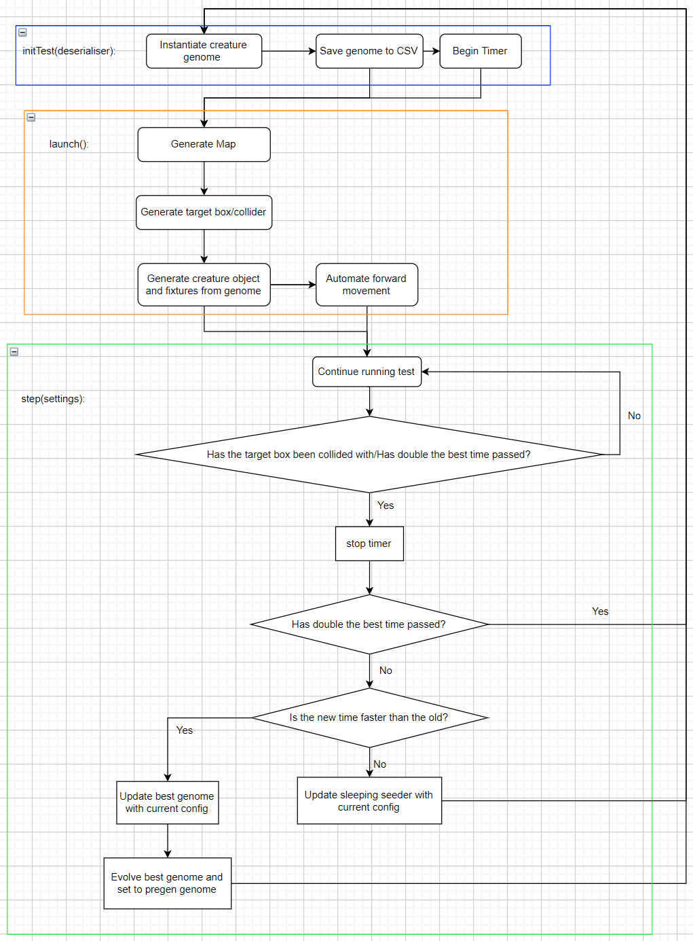
Evolution Integration – EVC
Begin test/timer.
Evolve current best genome.
Wait for fitness evaluator.
Invoke fitness evaluator.
Stop timer.
Evaluate invocation.
If time is too long.
If target met and with best speed.
If target met but slower than best.
Start again.
Notes:
Now just to briefly go over how the test and evolver classes work, I wanted to just illustrate to you how the process works in design.
In the test class, an inherited method called step is used and this is where the runtime aspect is controlled.
At each frame, this method will assess the current state of the test and determine whether to continue to the next frame, kill the test or activate the fitness evaluator.
This method is also responsible for activating the test and it works as follows.
It will begin the test and start a timer.
In the first generation, a genome is provided to act as the seed and this is evolved at the beginning before the task begins.
Step evaluator will monitor the state of the machine and then invoke the fitness evaluator when one of the triggers mentioned in the previous slide, occurs.
Once this invocation has been made, the timer is stopped and first checks to see if it has surpassed double the previous best time. If it has, it will start the test again. In the previous state.
If it hasn’t, then the target has been met and the program next calculates whether the current time of the creature is faster than the current best. If it is, it will replace the current best genome with the genome that has just run and run the test again.
If it isn’t faster, it will still save this genome as a spare seeder in-case the generations accidentally meet a local optima and are prevented from reaching a global optima. Before starting again.
In the case of the spare seeder, this will replace the current best after a certain number of failures to evolve has been met.

Slide 17
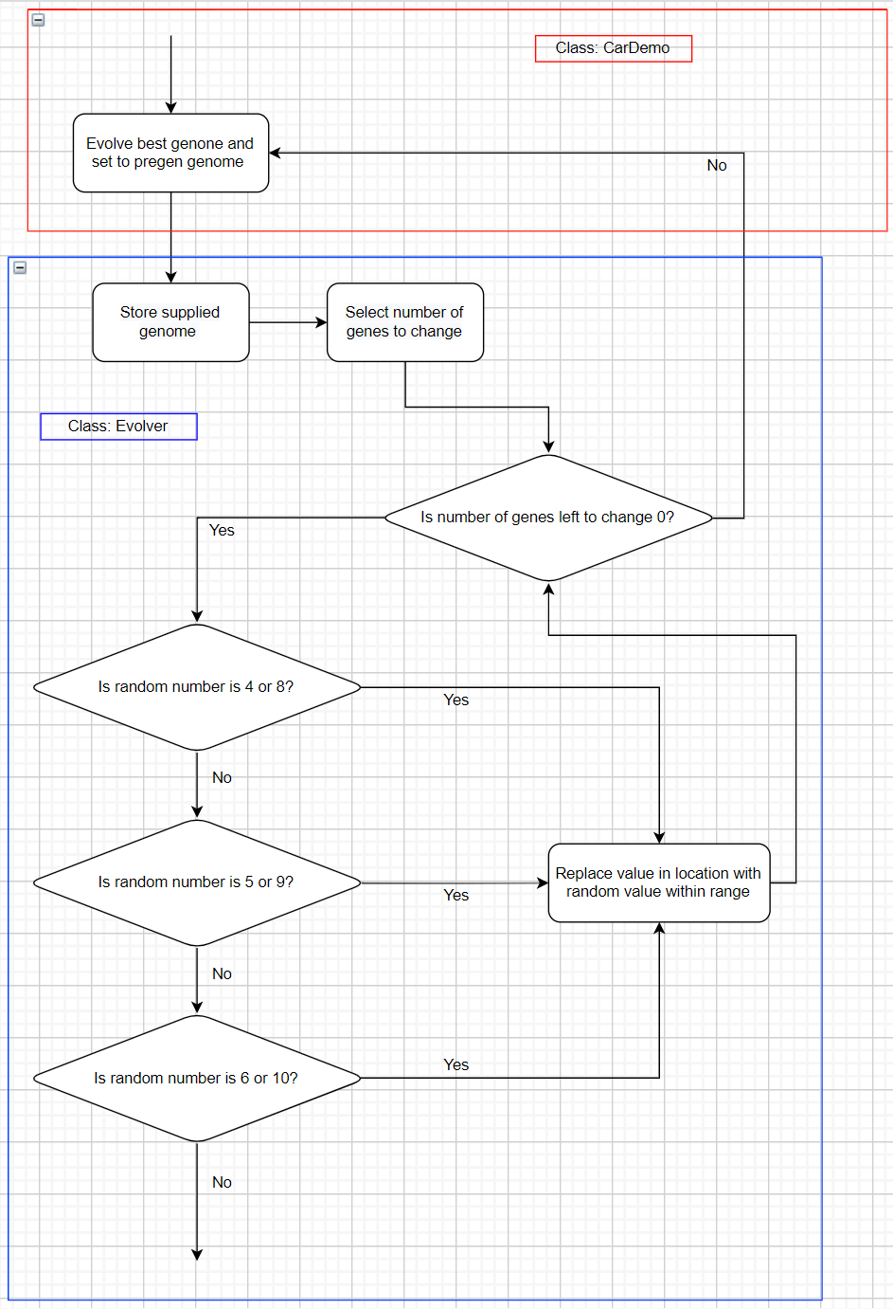
Evolution Integration – Evolver
Store provided genome from EVC.
Select a number of genes to change.
Is number of changes more than 0?
Generate random number.
If number is x or y?
Replace old gene with new.
Return new genome to EVC.
Notes:
The evolver on the other hand is where the greedy tour algorithm is stored and where any recombination occurs.
This will work by accepting the input genome that is supplied by the test class.
Run a loop querying whether the pre-set number of genes have been changed. And if so, the supplied and now evolved genome will be returned to the test class for the next generation.
If however, the number of changes defined have not occurred, a random number will be generated between the range of 3 and 11 in order to select a gene to replace.
Once a random number in this range is selected, various if statements will query if the number generated and the number in their criteria match.
So for example, if the random number was 6, the first query will ask if the number is 3 or 7 which are one of the wheel’s radius.
Failing that, it will then query if the number is 4 or 8, then 5 or 9, then 6 or 10 which will be either of the wheel’s torque. It will then generate a new random number with a specified range, replace this gene and return to the original query of whether the pre-set number of recombination’s has occurred, until completion.

Slide 18
Recombination Limits
Wheel Radius: 0.01f to 1.0f
Wheel Speed: -200.0f to 0.0f
Wheel Torque: 0.0f to 100.0f
Frequency Dampening: 1.0f to 10.0f
Wheel Activated: True/False
Notes:
The ranges mentioned before are as follows.
These were tested to ensure that the car in action has some positive feedback and is at least viable.
And they produce some interesting results.
There used to be a gene to determine whether the wheel joint was activated or deactivated.
But with the possibility of either wheel being able to have nill speed or torque. The matter of whether the wheel was activated or not would be redundant and may probably create genetic biases that are unwelcome.

Slide 19
Demo
Source Repo: https://github.com/Iqasim94/180021745-FYP-EvolvingVirtualCreatures
Screen Capture: https://1drv.ms/v/s!Agy77BMmbQXLgt1ryt-S41t70uBKug?e=ohK9B9
Demo Results: https://1drv.ms/x/s!Agy77BMmbQXLgt0cCmLD8P5a1eH7ew?e=4AekbO
Notes:
Now I think I’ve had you wait long enough to see any action.
And for you, I’ve had the pleasure of recording over 2 hours of testing with accommodating data.
I would like a moment to stress once again that this project is still in its early stages of developments and all functionality with no concern toward plausibility.
And to illustrate this really well to you, allow me to take you to test 143 where we witness the fittest creature of this entire run.

Slide 20
Findings
Very early but proves possible.
Many physical aspects to consider that were unforeseen.
Run 144 Torques were 96.91f and 58.32f
Newton’s 3rd Law: “For every action, there is an equal and opposite reaction”
Seeder did not function optimally.
jBox2D mysteries.
Greedy tour algorithm being too simplistic and non-directional.
-log(x) not represented in results.
It’s clear why Sims chose to evolve phenotypes.
Notes:
This project has proved to me, though extremely primitive and in it’s early stages, that evolution is very possible to replicate, given enough time and understanding.
Many variable were not factored into this research from lack of expectation and understanding. I thought initially it would be simple enough to create an environment and throw a simple creature at it and watch it go without any understanding of the connotations of some physical interactions.
For instance, and I mentioned this very briefly earlier. One of jBox2D’s fundamental forces are impulses, and these are forces and responses produced from contact forces and naturally this is something I thought I understood until sat in front of this project have having my understanding tumble right in front of me.
A clear example of this, was run 143 of the demo I just previewed to you, ignoring the tenacity of it’s back flips to success. For a while I did not understand why something like this would happen, before reading into impulse forces and revising the laws of physics.
Newton’s 3rd law dictate “For every action, there is an equal and opposite reaction.”
And this indicated to me that if we were to consider this environment to have true physics, then what is likely the case is that the reactionary friction force produced by the ground, is not strong enough to produce an equal friction force to what is required by the power of the torque that existed in this genome.
And it’s an insight like this that make me consider that for true evolution, I may not only be able to focus on the genetic construction of the creature alone, but perhaps find a way to integrate environmental aspects into the weighting. Similar to how Sims had his creatures work toward a behaviour.
Upon evaluating the results from the demo, I had noticed the best time at some point had gotten worse.
And after some testing, I found that the seeder component I added was flawed in that, once it had acted, it replaced the best time with its current time also. This is a simple fix and may lead us to have evolutions occur at a higher rate.
There is also a strange case of the jBox2D X-Files, the homicide stories. One of the major flaws that began to occur in testing is that for some reason, gene 4, wheel radius 1, had no influence on the creature whatsoever.
You can notice also from the demo clip that when the wheels changed size, they were always the same and this was because no matter what, gene 7, wheel size 2 determined the size of both wheels, this reduces the effect of a truly genotypical evolution.
Probably the most effectual realisation made from these results is the flaw that is the greedy tour algorithm. Rather this was expected but I didn’t want it to be proven true.
Greedy tour is far too simplistic and non-directional to produce many valuable evolutions. Concessions were made with seeders to attempt to provide some sense of direction but overall, this has proven that something more is required to prove evolution cycles can be replicated and understood.
Something more akin to crossover or graft evolution techniques.
We also never were able to display a negative logarithm of x curve behaviour in the evolution cycles and this is likely due to the greedy tour algorithms lack of direction. The evolutions occurred at random intervals instead.
It’s clear to me why Sims chose the route that he did and if I were to begin this project again, this is the route I would begin at, not eventual step into.

Slide 21
Future Developments
Replace greedy tour with crossover.
Move to 3D.
Begin to control more variables inside the genomes.
Understanding and controlling environmental factor.
Attempting to use the environment to force weights and biases upon evolution.
Notes:
Expanding on what I just spoke about,
I would first experiment with replacing the greedy tour algorithm with a crossover algorithm and employ some technique of sustaining a pair of parents.
This could simply be by using the 2 best generations and perform a crossover on these, replacing the parent genome with the offspring that is fitter.
Next, I would expect to expand outwards and move straight into the 3D implementation. I could spend time further working out the mysteries of jBox2D but complete mastery of a 2D engine wouldn’t serve the purpose of creating a development platform for innovators and engineers.
And whatever mysteries that existed in jBox2D may vanish in transferring over to a 3D implementation using jBullet or something similar.
The aim at the point onward would be to slowly expand that range at which evolutions occur.
Understanding all genome based evolutions before moving towards phenotypical ones.
I would like to also learn to control environmental factors and implement a way to force weights towards specific genes based on these, to better influence the reconfiguration process and simulate true evolution whilst also further optimising the proposed software to the client’s work environment that they’d planned to use the concepts in.
These would be my future aims at this point in time.

Slide 22
Acknowledgements
Dr Peter Lewis
Dr Megan Robertson
Aston University
Notes:
Now, I’d like to take a moment to embrace and acknowledge some pillars of my success in this project.
To Dr Peter Lewis, for indoctrinating me into the ways of finally being able to think. Learning to learn. And take myself into a place where this project stopped feeling like a job and instead as an exploratory process in much the same way he describes as “walking into a shed and messing around with tools, looking outside and finding the day is already over.”
To Dr Megan Robertson, for helping me choose this project and overcome my self-doubt in my competence for the subject. And for also helping me to make sure I could materialise this project with absolute feasibility.
Lastly, to Aston University to equipping me with the expertise, knowledge and absolute cheek to take on this final year project with some competence.
Thank you all.

Slide 23

Questions
Notes:
That is the end of my demo
I will now be taking your questions.

